Slide 2
CASH MANAGEMENT REPORTING
VS
EXPENSE MANGEMENT REPORTING
(ACCRUALS)
Axel CHAPTAL | axel.chaptal@globalinitiative.net
Program Manager meeting
04 April 2022

Slide 3
3
PRINCIPLE
Cash Management reporting : money in – money out method (bank)
Expense Management reporting (Accruals) : Time is key
When expense occurred ? When can we file revenue?
GI-TOC = Accruals

Slide 4
4
PRINCIPLE
https://www.youtube.com/watch?v=GEZZftO_VrE

Slide 5
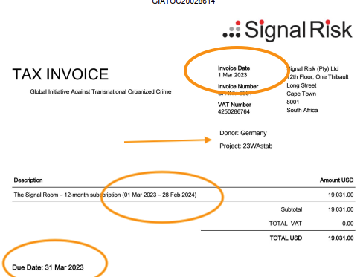
5
INVOICE EXAMPLE PAID IN ADVANCE

Slide 6
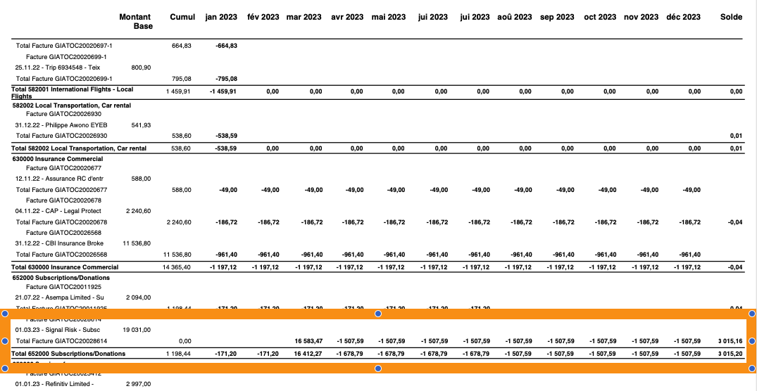
6
INVOICE EXAMPLE PAID IN ADVANCE

Slide 7
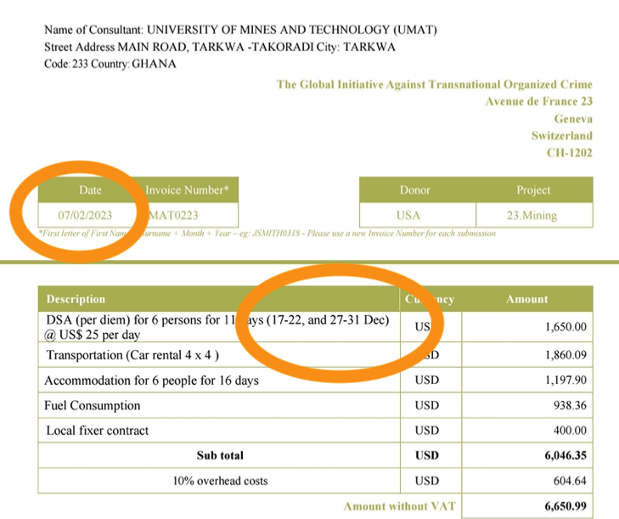
7
INVOICE EXAMPLE AFTER – ACCRUAL NEEDED

Slide 8
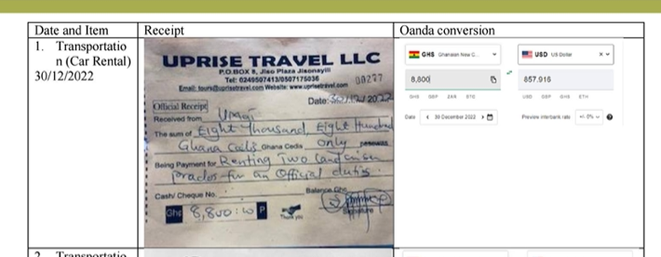
8
INVOICE EXAMPLE AFTER – ACCRUAL NEEDED

Slide 9
9
INVOICE EXAMPLE AFTER – ACCRUAL NEEDED

Slide 10
10
LINK TO PROJECT MANAGMENT
Before 1st day of contract
During contract
After last day of contract
Example Grant from 01 October 2022 till 30 November 2022 :
Flight on 30 September = NO
Contract with supplier for work in December = NO
Per diem on 10 October = YES

Slide 11
11
LINK WITH PROJECT MANAGEMENT

Slide 12
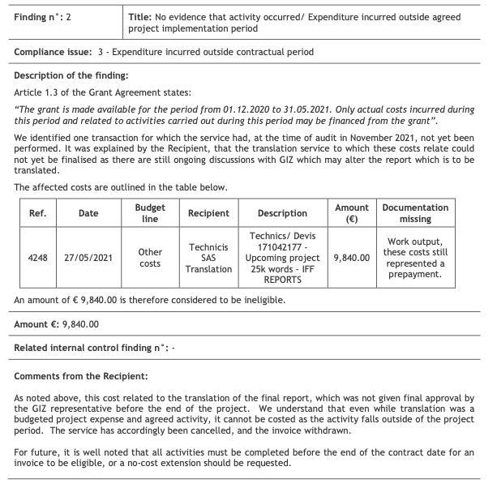
12
LINK TO AUDIT
GIZ IFFS 2:

Slide 13
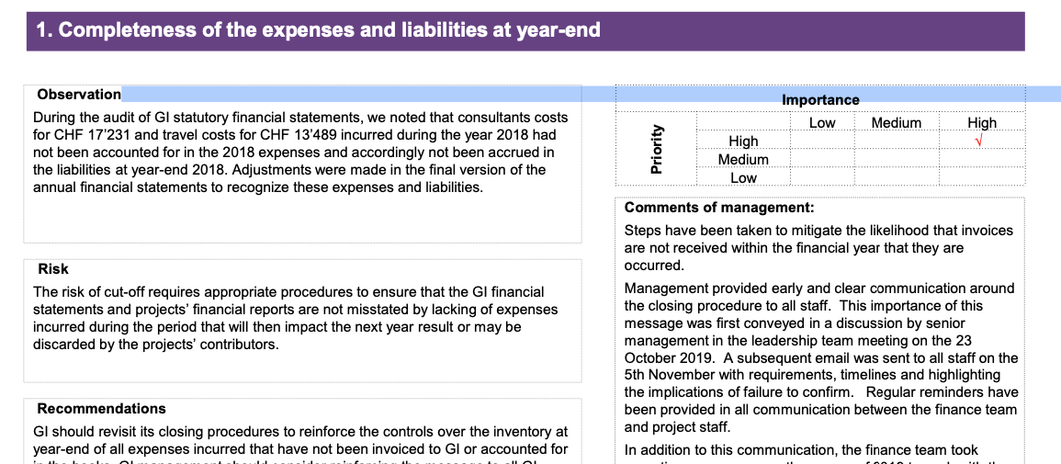
13
LINK TO AUDIT - ACCRUAL NOT DONE
GVA STATUTORY 2019

Slide 14
14
THANK YOU

