Slide 2
A WONDERFUL JOURNEY WITH GI’S FINANCE TEAM
unveil the mystery behind the scene
31 March 2023

Slide 3
3
1
MEET THE CREW & PARTNERS

Slide 4
AXEL
Based in Geneva

Slide 5
REDEATE
Based in Geneva

Slide 6
LUCIANA
Based in Vienna

Slide 7
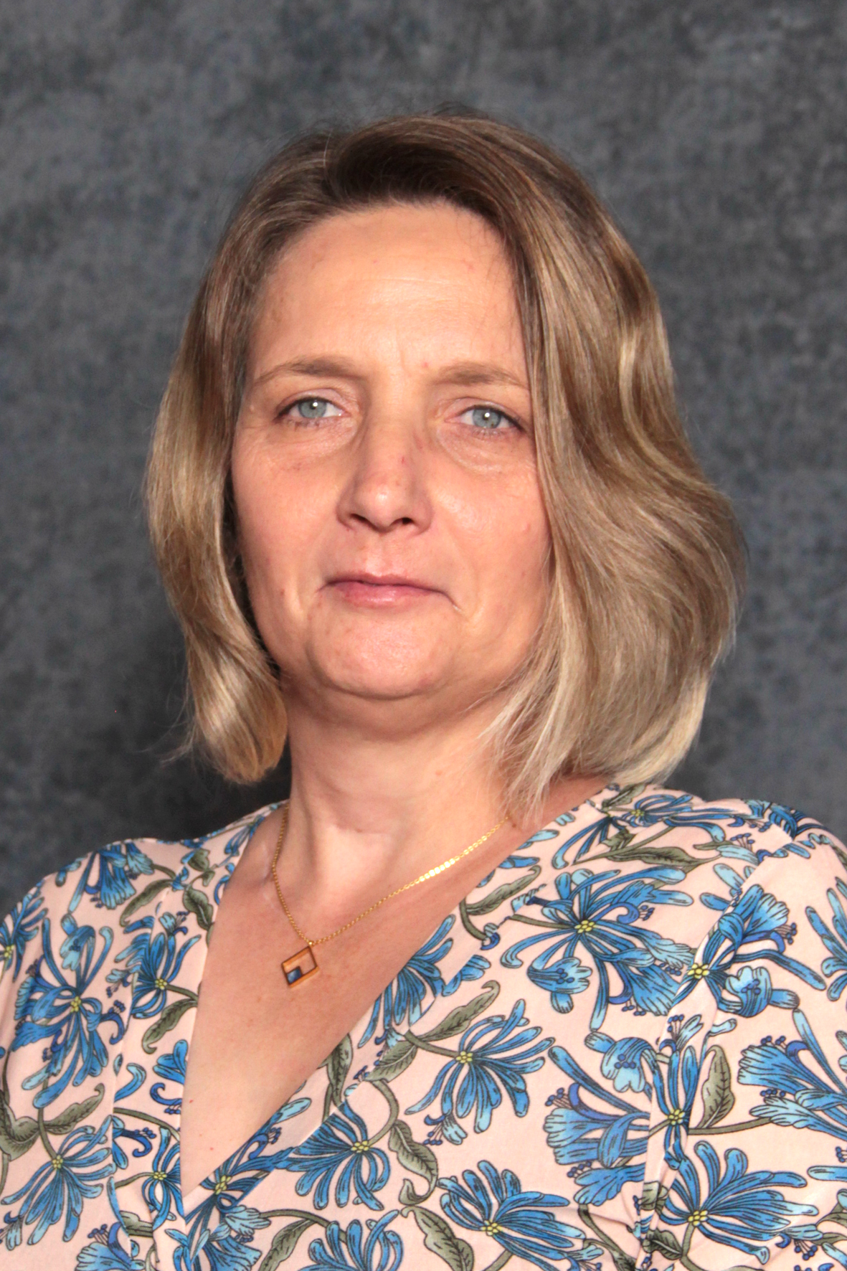
THERESA
Based in Cape Town

Slide 8
PAUL
Based in Geneva

Slide 9
ADRIAN
Based in Cape Town and working for

Slide 10
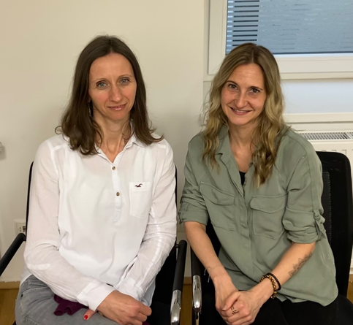
REKA & DANIELA
Based in Vienna and working for

Slide 11
11
2
FINANCE LINGO

Slide 12
12
FINANCIAL LINGO
Expense :
An expense is the cost of operations that a company incurs to generate revenue. Common expenses include payments to consultants, employee wages, travel costs, and office supplies.
Income / Revenue :
Revenue is the income that an organisation has from its normal business activities, usually by signing grants with donors.
Surplus :
A surplus occurs when income earned exceeds expenses paid.
Deficit :
Deficit is deemed to be the opposite of surplus, that represents an overspending.
Statement of Income and Expenses :
Also known as profit and loss (P&L) statement is a financial statement that summarizes the revenues, costs, and expenses incurred during a specified period, usually a fiscal quarter or year.

Slide 13
13
FINANCIAL LINGO
Asset :
An asset is anything of value or a resource of value that can be converted into cash : furniture, securities, invoices that we sent to partners in exchange for services we provided.
At a personal level that will be a house, car, investments, artwork, or home goods.
Liability:
A liability is something a person or organisation owes, usually a sum of money. Liabilities are settled over time through the transfer of economic benefits including money, goods, or services.
A liability is an obligation between one party and another not yet completed or paid for.
Balance Sheet:
A balance sheet is a financial statement that reports a company's assets, liabilities at a specific point in time.

Slide 14
14
FINANCIAL LINGO
Cash accounting system :
The cash basis of accounting recognizes revenues when cash is received, and expenses when they are paid.
Accrual accounting system (used by the GI):
Revenues and expenses are recorded when they are earned, regardless of when the money is actually received or paid. For example, we are recording revenue when a project is complete, rather than when the GI get paid. Similar process for expenses.
https://bench.co/blog/accounting/cash-vs-accrual-accounting/
Work completed by The GI in 2022
Invoice Sent in 2023 to Donor
Revenue Recognized in 2022 not 2023
Accrued Revenue in 2022
Invoice paid in June 2023
Work completed by consultant in 2022
Invoice Received in 2023
Expense booked in 2022 not 2023
Accrued Expense in 2022
Invoice paid in December 2023

Slide 15
15
3
3 Legal Entities
3 Countries
110+ Staff Members
30+ Main Projects
Where & How are Expenses Booked?

Slide 16
16
3 Legal Entities in 3 Countries = 3 Accounting rules
The same type of expense will be treated differently from one entity to the other
Cape Town = IFRS for Small Entities 800 pages
Vienna = Austrian Generally Accepted Accounting Principles about 200 pages
Geneva = Code des Obligations about 4 pages

Slide 17
17
30+ Main projects split within 2 Entities (as of March 2023)

Slide 18
18
110+ Staff Members split within 3 Entities

Slide 19
19
LOVING HARVEST
THE GLOBAL INITIATIVE
INCOME
INCOME
GVA
VIE
EXPENDITURES
EXPENDITURES
TIME
TIME
EXPENDITURES
INCOME
CPT
EXPENDITURES

Slide 20
20
4
BANKING SYSTEM

Slide 21
21
Banking system within a country
Bank of International Settlements
Central Banks
Local Branch

Slide 22
22
Banking system between two countries
Bank of International Settlements
Central Banks
Local Branch
Bank of International Settlements
Central Banks
Local Branch
Bank of International Settlements
Central Banks
Local Branch
Intermediary Bank 2
Bank of International Settlements
Central Banks
Local Branch
Pmt initiated from UBS
Intermediary Bank 1
Initially transaction costs supported by GI
Final Recipient

Slide 23
23
ABA Routing Number VS BIC/SWIFT Codes
https://www.instantglobalpayments.com/blog/difference-between-bic-swift-and-aba-routing-number.php

Slide 24
24
Countries using IBAN structures but not related
SO WE ALWAYS NEED IBAN SWIFT, Account Number and or ABA and Account NUMBER
As IBAN don’t have the same structure nor the same function

Slide 25
25
INFORMATION CHECKED DURING TRANSFER
Information sent :
Final Recipient information :
Name, Address, City, Country
Currency and Amount
Purpose of the transaction
Banking Details of Recipient:
Name of the bank, Address, SWIFT, IBAN Account number, ABA, Branch
Checks made throughout the chain:
Destination Countries under embargo
Sanction List
Check made at the recipient’s Bank :
100% needs to match between Account number and name of the bank account otherwise rejected

Slide 26
26
5
VISIBLE PART OF THE ICEBERG

Slide 27
27
INFORMATION CHECKED ON AN INVOICE
Paying Environment
Legal Entity’s name
Donor and Project Code
Date of the invoice
Period of the expense, accrual yes, no?
Purpose of the payment
Consultant details
Name, Address, City, Country
Banking Details of Recipient only once while creating supplier in accounting system (1st payment):
Name of the bank, Address, SWIFT, IBAN Account number, ABA, Branch
Bank account name holder = Name on invoice otherwise payment is rejected
Amount of the invoice, Currency and TOTAL
Unique invoice number

Slide 28
28
Payment Process
Funds not ours anymore and Enter International banking process up to 2 weeks
Invoice sent to payme by project manager
Invoice sent to scanning company
Invoice proposed to payment
Payments in the bank
Invoice checked
Correct address
Information
Donor – Project
Bank Details
Invoice checked
Donor – Project…
Invoice filed in the accounting system – Banking details checked if new suppliers
2 levels of approval
Cosigned in the bank
Bank reconciliation
15 Days on Average

Slide 29
29
6
WHAT ELSE DO WE DO IN FINANCE ?

Slide 30
30
HUMAN RESOURCES
Salaries
Read all staff contracts
Liaise with payroll companies
Review salary calculations
Answer queries on social charges, tax, pension for Switzerland, Malta, UK, France, South Africa, Austria
Prepare permit request for Switzerland
Calculate holidays accruals when not taken during the calendar year
Compliance checks for donors and statutory audits
Harvest allocations Staff name and number of days allocated per project
Extract and prepare time sheets
Convert time into expense allocations onto projects.
Legal Implications
Payments to consultants and impact on social charges

Slide 31
31
FINANCIAL CONTROLLING
Expenditure reporting, financial statement preparation, and audit reporting
Read all donor’s contract and donor’s requirements
Look for implications in terms of operation for the GI / risks
Prepare donor’s reporting - monthly, quarterly, semi-annually, annually
Check regularly if we are under or overspending project per project
Prepare financial statement for the 3 entities including accruals calculation
Prepare consolidated financial statements
Payments
Check if invoice received by finance team within 3 emails address so please add NAME and invoice Number within subject when sending invoice otherwise won’t be processed by finance team
Check if processed in accounting system
Extract payment advice from bank
Send Proof Of Payments (POP) from 3 different banks depending on where the payment was made from
Respond to bank queries

Slide 32
32
7
ULTIMATE DESTINATION OF FINANCE TEAM

Slide 33
33
SEVERAL OBJECTIVES
Processing about 10’163 invoices
Having about 50’000 accounting entries across the 3 organization for which auditors can ask questions
Get payments done for the invoices and salaries
Answer any questions
Make sure we comply with :
- local accounting regulations
- donor’s requirements
TO :
- OBTAIN CLEAN AUDITS on PROJECTS
- OBTAIN CLEAN AUDITS for STATUTORY ACCOUNTS for the 3 ENTITIES

Slide 34
34
8
SUMMARY

Slide 35
35
SUMMARY
Finance team is dispersed, so is the GI
Some Financial Lingo
Components of Balance sheet, Income statement, Accruals
Implications for the GI to have 3 legal entities, 30 main projects, 110 staff members
Banking System
Difficulties to make International Transfers and importance to get pristine information
Visible part of the Finance team work’s
Filling invoices and making payments (15 days)
Other tasks performed by the Finance team
Lots of controlling and answering question
Preparation of reports for donors and auditors
Ultimate objectives of the team
Get clean audits on project to built credibility and trust
Get Clean audit on Statutory accounts

Slide 36
36
9
WHAT DO WE NEED FROM YOU

Slide 37
37
What do we need from you
Send us pristine invoices writing the Name and Invoice Number within the subject of the email
Fill up our lovely friend HARVEST on regular basis
Do ask for the POP only 20 days after the email is received on any of the payme email address.
Put the original invoice within your POP request.
Keep in mind the 30+ projects
Keep in mind the payment process and that you are an essential part of it
Thanks for your help us in achieving what is our common goal :
- CLEAN AUDITS on PROJECTS
- CLEAN AUDITS for STATUTORY ACCOUNTS for the 3 ENTITIES

Slide 38
PRESENTATION TITLE
38
THANK YOU

